Slide 1
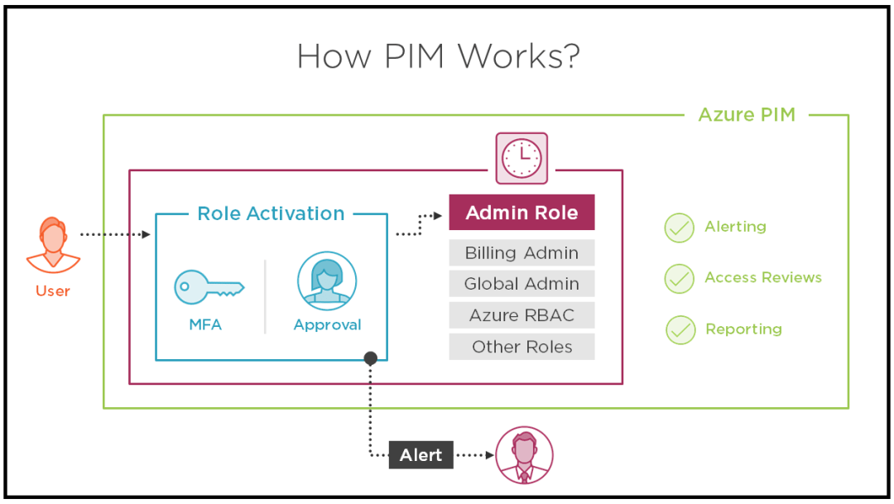
If you want a specified user to be able to implement Azure ad privileged identity management (also called PIM); the user must be with global administrator role in the organizational account (not a Microsoft account).
Steps : 1- to start using PIM in your directory, you must first enable PIM, 2- sign into the Azure portal as global administrator of your directory. 3 - you must be a global administrator with an organizational account (for example user@yourdomain.com, not @Microsoft account)

Slide 2

Your company has an Active Directory forest with a single domain, named weylandindustries.com. They also have an Azure Active Directory (Azure AD) tenant with the same name. You have been tasked with integrating Active Directory and the Azure AD tenant. You intend to deploy Azure AD Connect. Your strategy for the integration must make sure that password policies and user logon limitations affect user accounts that are synced to the Azure AD tenant, and that the number of necessary servers are reduced.
For pass-through authentication (and seamless SSO with password hash synchronization), you need one or more (we recommend three) lightweight agents installed on existing servers. These agents must have access to your on-premises Active Directory Domain Services, including your on-premises AD domain controllers. They need outbound access to the Internet and access to your domain controllers. For this reason, it's not supported to deploy the agents in a perimeter (DMZ) network.
www.docs.microsoft.com/en-us/azure/active-directory/hybrid/how-to-connect-pta

Slide 3
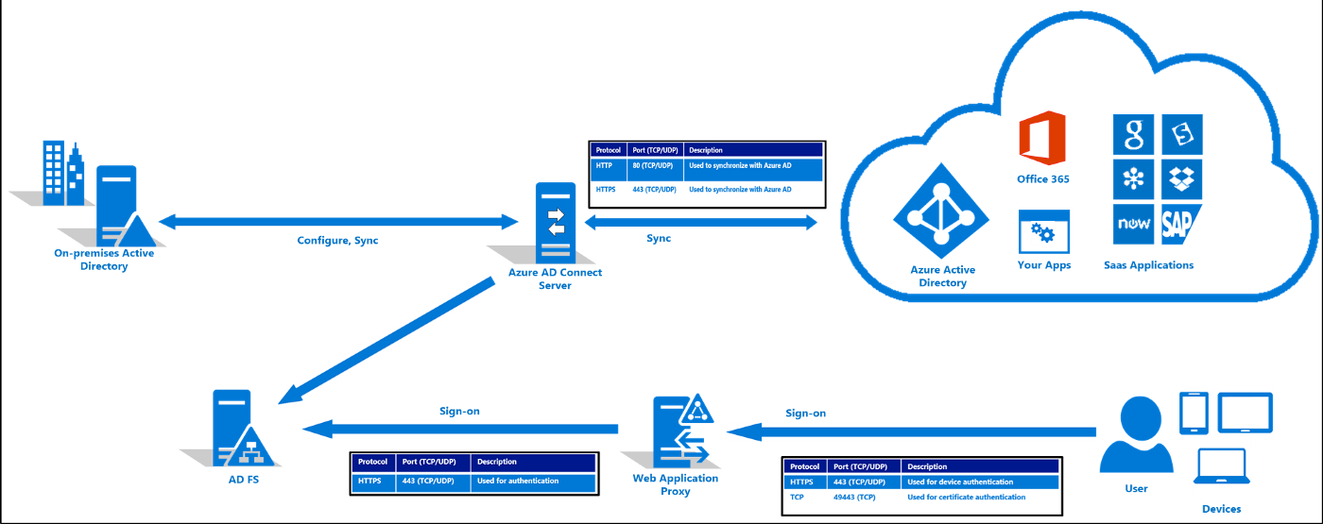
Your company has an Active Directory forest with a single domain, named weylandindustries.com. They also have an Azure Active Directory (Azure AD) tenant with the same name. You have been tasked with integrating Active Directory and the Azure AD tenant. You intend to deploy Azure AD Connect. Your strategy for the integration must make sure that password policies and user logon limitations affect user accounts that are synced to the Azure AD tenant, and that the number of necessary servers are reduced.
- A federated authentication system relies on an external trusted system to authenticate users. Some companies want to reuse their existing federated system investment with their Azure AD hybrid identity solution. The maintenance and management of the federated system falls outside the control of Azure AD. It's up to the organization by using the federated system to make sure it's deployed securely and can handle the authentication load.

Slide 4
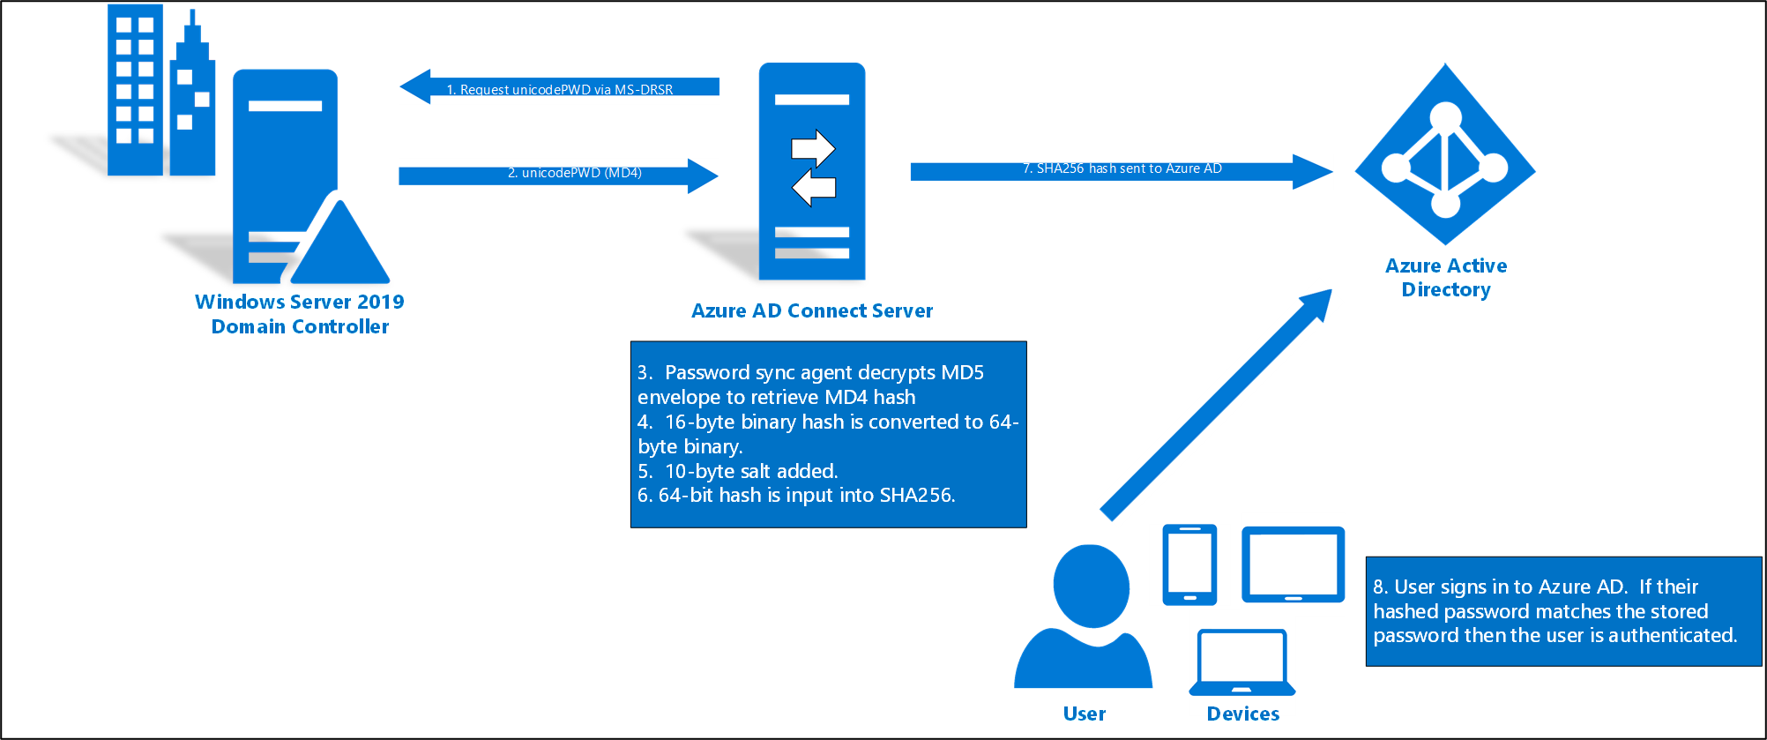
Your company has an Active Directory forest with a single domain, named weylandindustries.com. They also have an Azure Active Directory (Azure AD) tenant with the same name. You have been tasked with integrating Active Directory and the Azure AD tenant. You intend to deploy Azure AD Connect. Your strategy for the integration must make sure that password policies and user logon limitations affect user accounts that are synced to the Azure AD tenant, and that the number of necessary servers are reduced.
- Recommend the use of password hash synchronization and seamless SSO. Password hash synchronization requires the least effort regarding deployment, maintenance, and infrastructure. This level of effort typically applies to organizations that only need their users to sign into Office 365,
SaaS apps, and other Azure AD-based resources. When turned on, password hash synchronization is part of the Azure AD Connect sync process and runs every two minutes.

Slide 5
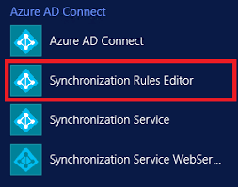
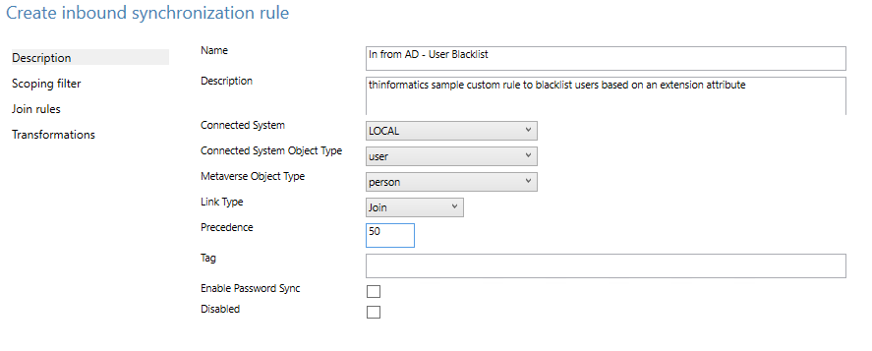
Your company has an Active Directory forest with a single domain, named weylandindustries.com. They also have an Azure Active Directory (Azure AD) tenant with the same name. After syncing all on-premises identities to Azure AD, you are informed that users with a givenName attribute starting with LAB should not be allowed to sync to Azure AD.
- You should make use of the Synchronization Rules Editor to create an attribute -based filtering rule.
Explanation: Use the Synchronization Rules Editor and write attribute-based filtering rule

Slide 6
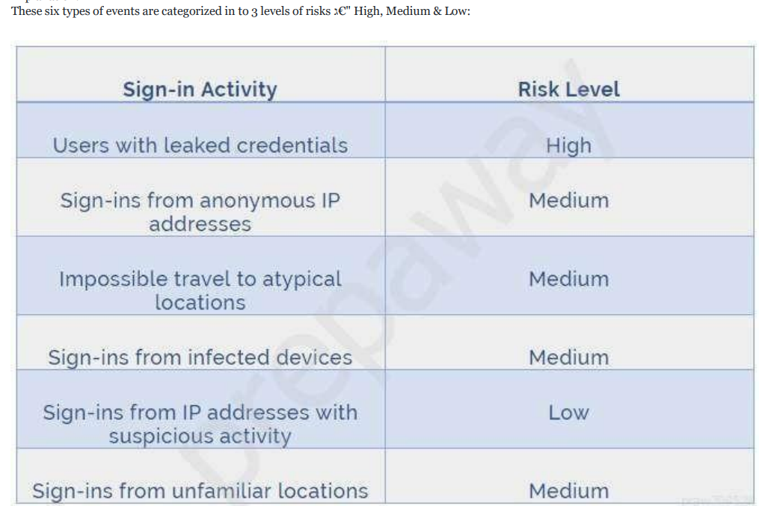

Slide 7
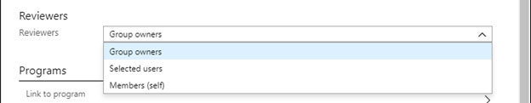
In the Reviewers section, select either one or more people to review all the users in scope. Or you can select to have the members review their own access. If the resource is a group, you can ask the group owners to review.

Slide 8
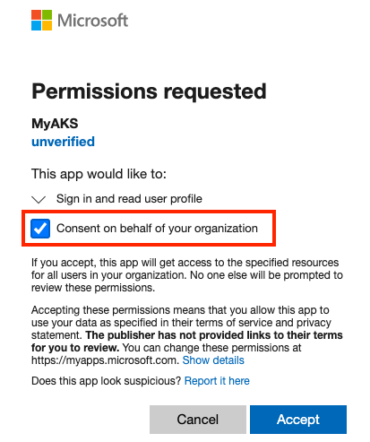
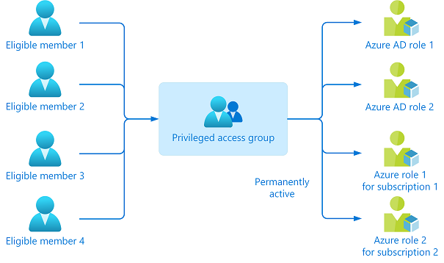
Your company recently created an Azure subscription. You have subsequently, been tasked with making sure that you are able to secure Azure AD roles by making use of Azure Active Directory (Azure AD) Privileged Identity Management (PIM). What action should you take FIRST?
- You should consent to Azure Active Directory (Azure AD) Privileged Identity Management (PIM).

Slide 9
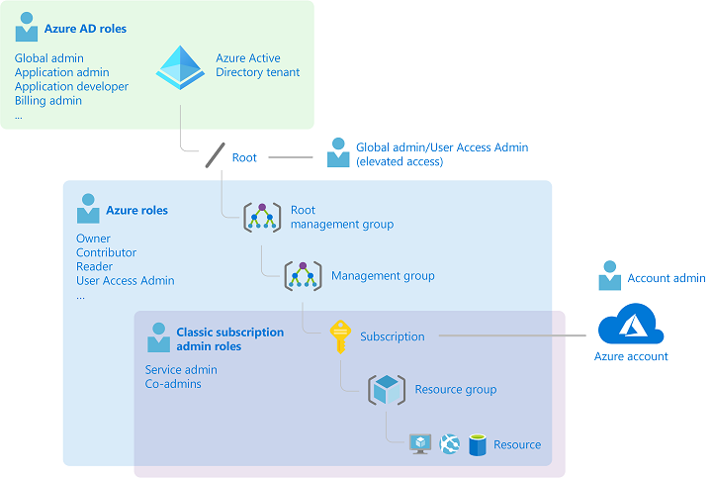
You have been tasked with creating a different subscription for each of your companyגs divisions. However, the subscriptions will be linked to a single Azure Active Directory (Azure AD) tenant. You want to make sure that each subscription has identical role assignments. You make use of Azure AD Privileged Identity Management (PIM).
No adjustment required - Azure AD Privileged Identity Management (PIM) service also allows Privileged Role Administrators to make permanent admin role assignments

Slide 10
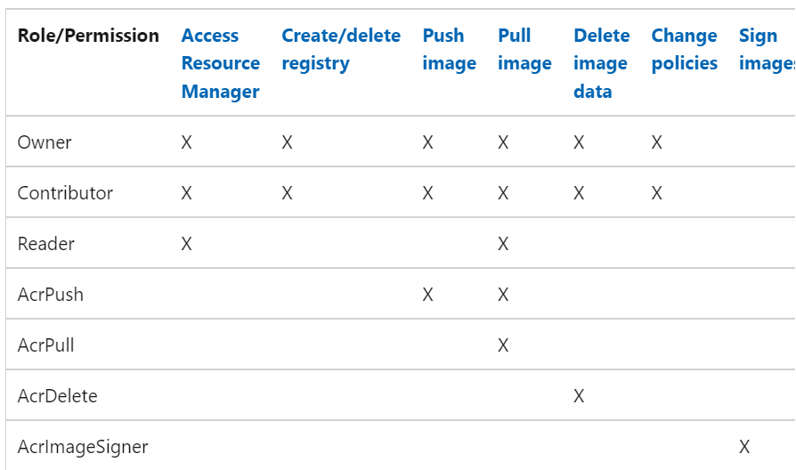

Slide 11
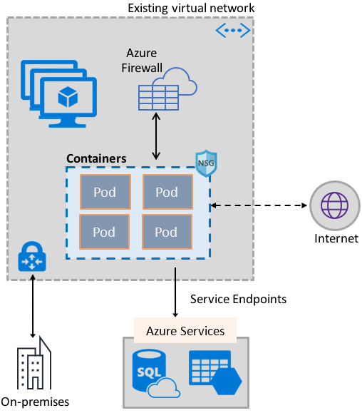
Your Company’s Azure subscription includes a virtual network that has a single subnet configured. You have created a service endpoint for the subnet, which includes an Azure virtual machine that has Ubuntu Server 18.04 installed. You are preparing to deploy Docker containers to the virtual machine. You need to make sure that the containers can access Azure Storage resources and Azure SQL databases via the service endpoint. You need to perform a task on the virtual machine prior to deploying containers.
Solution: You install the container network interface (CNI) plug-in
Azure Virtual Network container network interface (CNI) plug-in installs in an Azure Virtual Machine. The plug-in supports both Linux and Windows platform. The plug-in assigns IP addresses from a virtual network to containers brought up in the virtual machine, attaching them to the virtual network, and connecting them directly to other containers and virtual network resources. The plug-in doesn גTM€t rely on overlay networks, or routes, for connectivity, and provides the same performance as virtual machines. The following picture shows how the plug-in provides Azure Virtual Network capabilities to Pods:

Slide 12
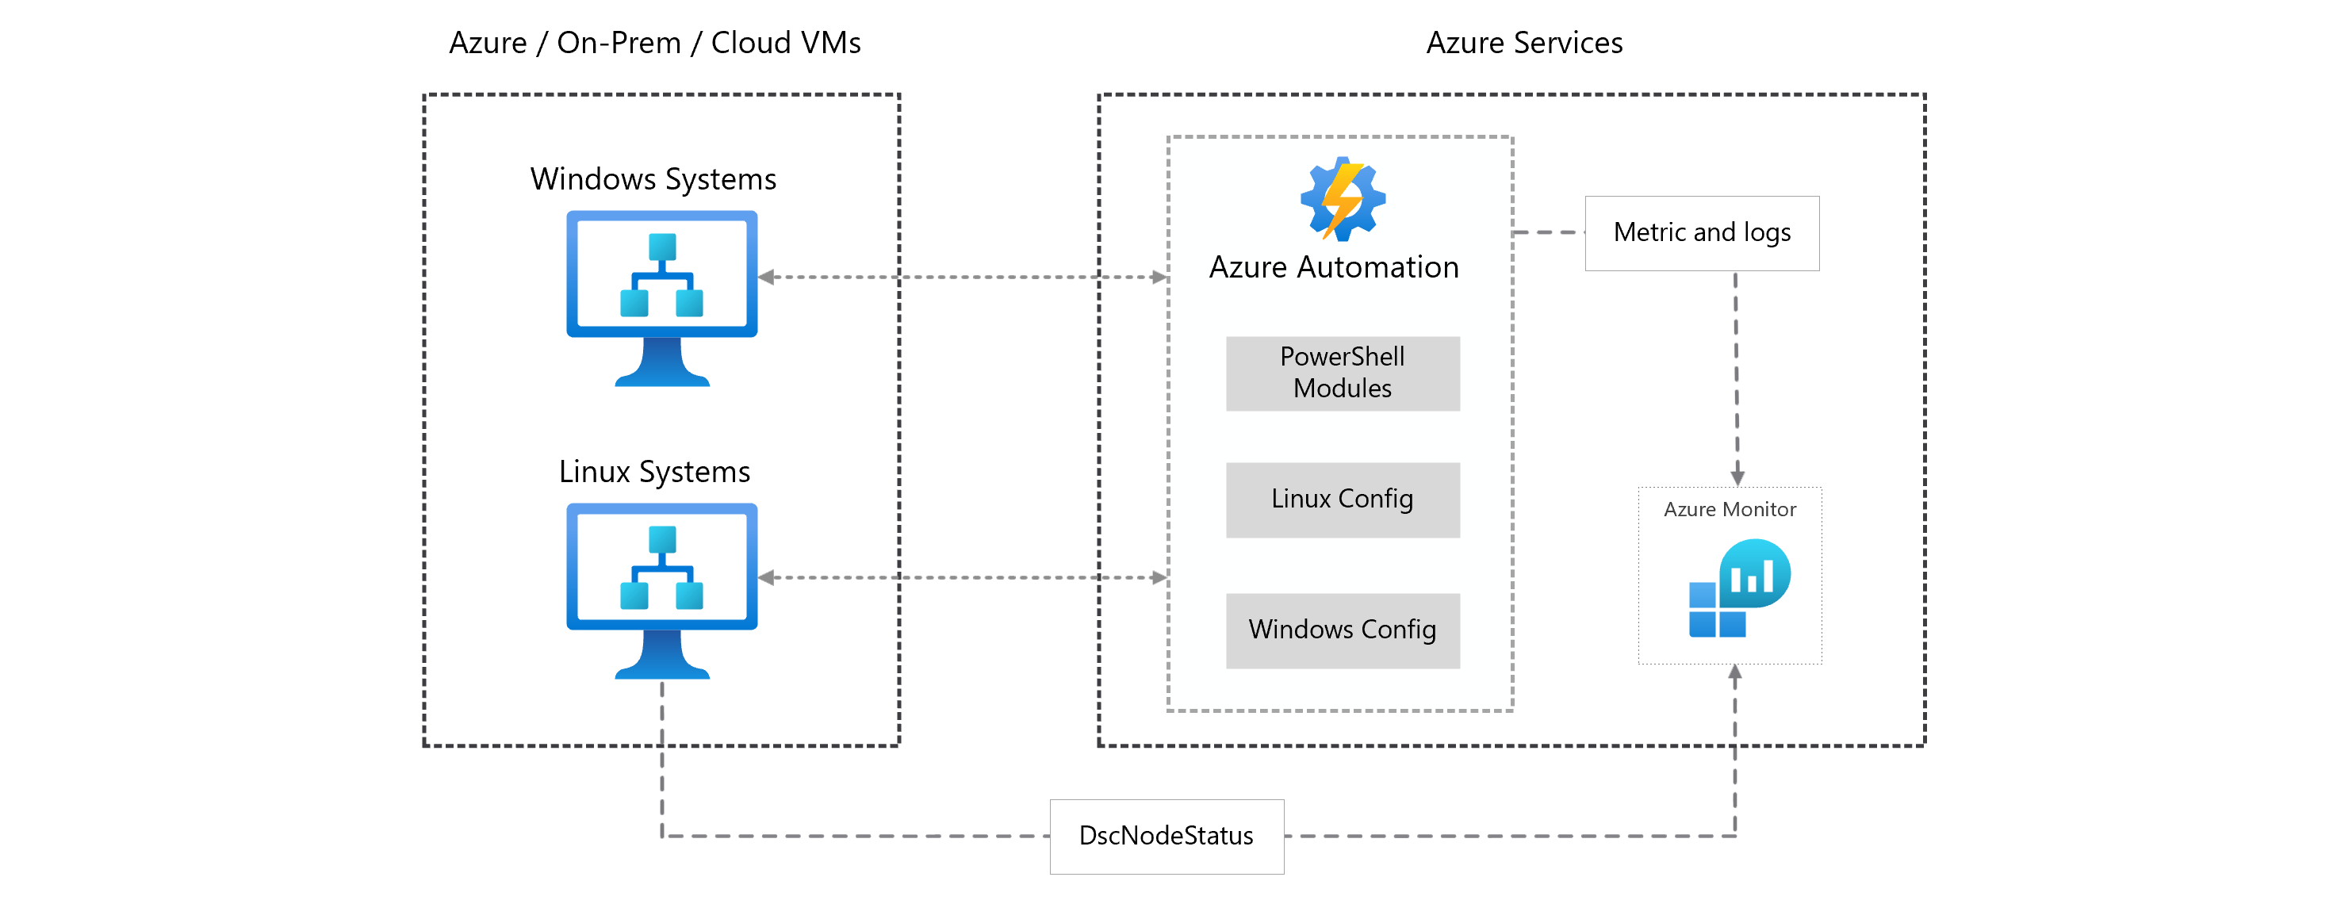
You make use of Azure Resource Manager templates to deploy Azure virtual machines. You have been tasked with making sure that Windows features that are not in use, are automatically inactivated when instances of the virtual machines are provisioned. Which of the following actions should you take?
You should make use of Azure Automation State Configuration
You can use Azure Automation State Configuration to manage Azure VMs (both Classic and Resource Manager), on-premises VMs, Linux machines, AWS VMs, and on-premises physical machines.
Note: Azure Automation State Configuration provides a DSC pull server similar to the Windows Feature DSC-Service so that target nodes automatically receive configurations, conform to the desired state, and report back on their compliance. The built-in pull server in Azure Automation eliminates the need to set up and maintain your own pull server. Azure Automation can target virtual or physical Windows or Linux machines, in the cloud or on-premises.
configuration windowsfeatures {
Import-DscResource -ModuleName PsDesiredStateConfiguration
node localhost {
WindowsFeature WebServer {
Ensure = "Present"
Name = "Web-Server"
}
}
}
az deployment group create --resource-group state-configuration \
--template-uri https://raw.githubusercontent.com/mspnp/samples/master/solutions/azure-automation-state-configuration/azuredeploy.json

Slide 13
Your company גTM€s Azure subscription includes Windows Server 2016 Azure virtual machines. You are informed that every virtual machine must have a custom antimalware virtual machine extension installed. You are writing the necessary code for a policy that will help you achieve this. Which of the following is an effect that must be included in your code?
DeployIfNotExists
Explanation: DeployIfNotExists executes a template deployment when the condition is met
Effects currently supported in a policy definition:
Append
Audit
AuditIfNotExists
Deny
DeployIfNotExists
Disabled
Manual (preview)
Modify

Slide 14
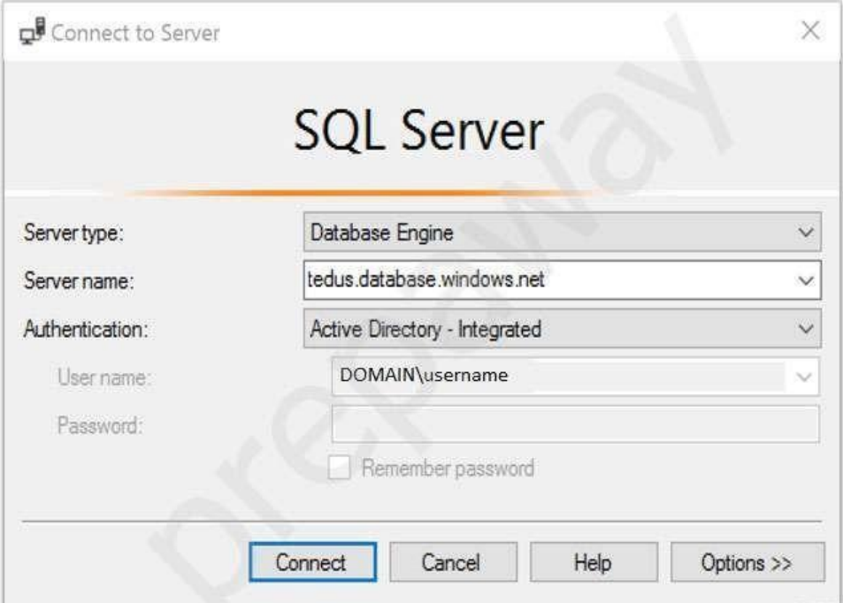
Your company makes use of Azure Active Directory (Azure AD) in a hybrid configuration. All users are making use of hybrid Azure AD joined Windows 10 computers. You manage an Azure SQL database that allows for Azure AD authentication. You need to make sure that database developers are able to connect to the SQL database via Microsoft SQL Server Management Studio (SSMS). You also need to make sure the developers use their on-premises Active Directory account for authentication. Your strategy should allow for authentication prompts to be kept to a minimum. Which of the following is the authentication method the developers should use?
Active Directory integrated authentication
Azure AD can be the initial Azure AD managed domain. Azure AD can also be an on-premises Active Directory Domain Services that is federated with the Azure AD. Using an Azure AD identity to connect using SSMS or SSDT The following procedures show you how to connect to a SQL database with an Azure AD identity using SQL Server Management Stud io or SQL Server Database Tools. Active Directory integrated authentication Use this method if you are logged in to Windows using your Azure Active Directory credentials from a federated domain.
Start Management Studio or Data Tools and in the Connect to Server (or Connect to Database Engine) dialog box, in the Authentication box, select Active Directory - Integrated. No password is needed or can be entered because your existing credentials will be presented for the connection.
Select the Options button, and on the Connection Properties page, in the Connect to database box, type the name of the user database you want to connect to. (The AD domain name or tenant IDג €option is only supported for Universal with MFA connection options, otherwise it is greyed out.)

Slide 15
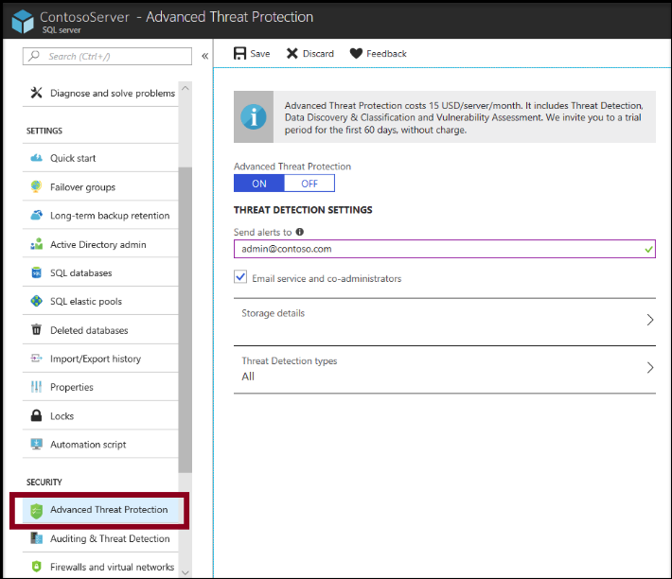
You have been tasked with enabling Advanced Threat Protection for an Azure SQL Database server. Advanced Threat Protection must be configured to identify all types of threat detection. Which of the following will happen if when a faulty SQL statement is generate in the database by an application?
- A Vulnerability to SQL injection alert is triggered.

Slide 16
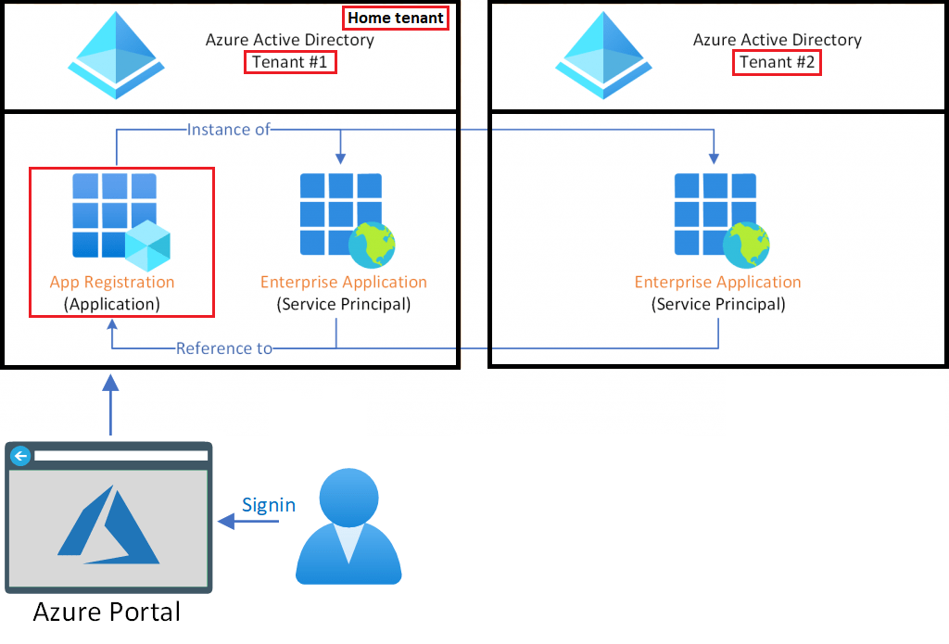
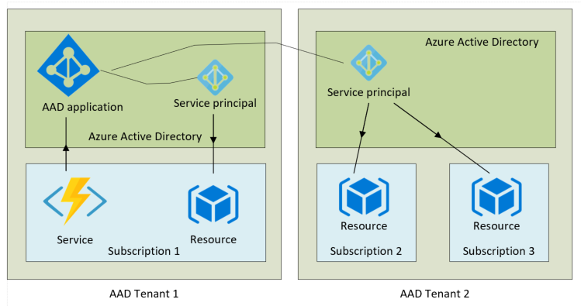
Establish a solution that satisfies the requirements. You are in the process of creating an Azure Kubernetes Service (AKS) cluster. The Azure Kubernetes Service (AKS) cluster must be able to connect to an Azure Container Registry. You want to make sure that Azure Kubernetes Service (AKS) cluster authenticates to the Azure Container Registry by making use of the auto-generated service principal.
Solution: You create an Azure Active Directory (Azure AD) role assignment
When you create an AKS cluster, Azure also creates a service principal to support cluster operability with other Azure resources. You can use this auto-generated service principal for authentication with an ACR registry. To do so, you need to create an Azure AD role assignment that grants the cluster's service principal access to the container registry.

Slide 17
Your company has an Azure subscription that includes two virtual machines, named VirMac1 and VirMac2, which both have a status of Stopped (Deallocated). The virtual machines belong to different resource groups, named ResGroup1 and ResGroup2. You have also created two Azure policies that are both configured with the virtualMachines resource type. The policy configured for ResGroup1 has a policy definition of Not allowed resource types, while the policy configured for ResGroup2 has a policy definition of Allowed resource types. You then create a Read-only resource lock on VirMac1, as well as a Read-only resource lock on ResGroup2. Following would be TRUE with regards to the scenario:
- You will NOT be able to start VirMac1.
You will NOT be able to create a virtual machine in ResGroup2
In Azure Policy, we offer several built-in policies that are available by default. For example:
Allowed Storage Account SKUs (Deny): Determines if a storage account being deployed is within a set of SKU sizes. Its effect is to deny all storage accounts that don't adhere to the set of defined SKU sizes.
Allowed Resource Type (Deny): Defines the resource types that you can deploy. Its effect is to deny all resources that aren't part of this defined list.
Allowed Locations (Deny): Restricts the available locations for new resources. Its effect is used to enforce your geo-compliance requirements.
Allowed Virtual Machine SKUs (Deny): Specifies a set of virtual machine SKUs that you can deploy.
Add a tag to resources (Modify): Applies a required tag and its default value if it's not specified by the deploy request.
Not allowed resource types (Deny): Prevents a list of resource types from being deployed.

Slide 18
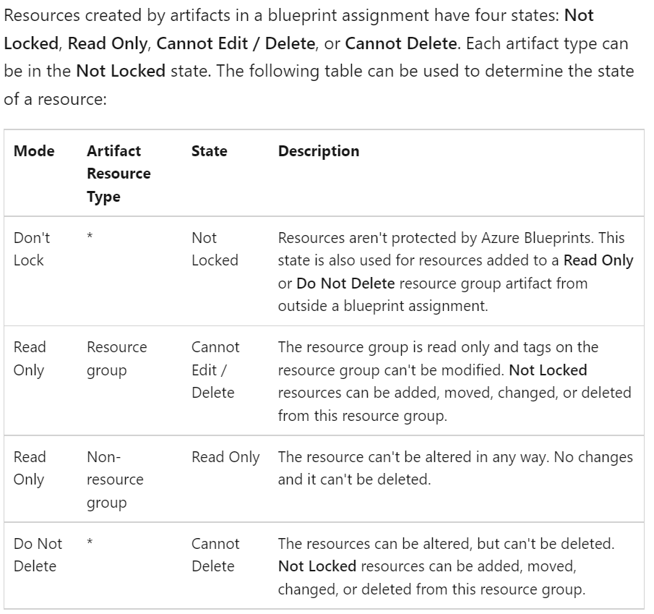

Slide 19
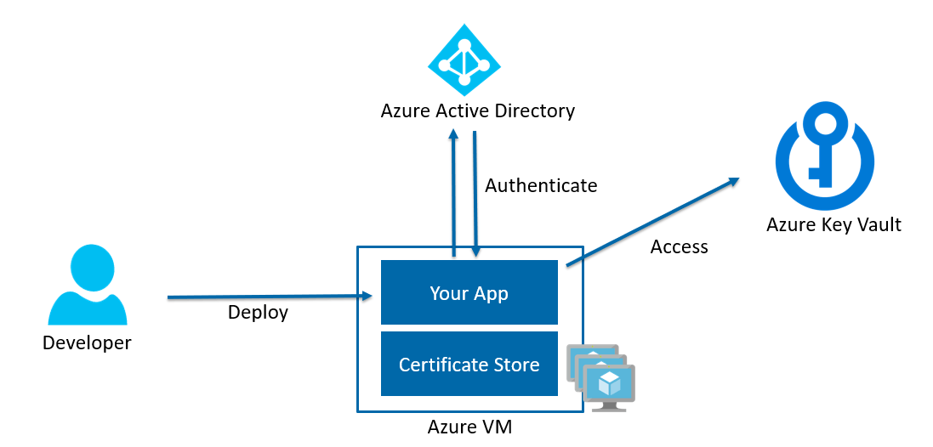
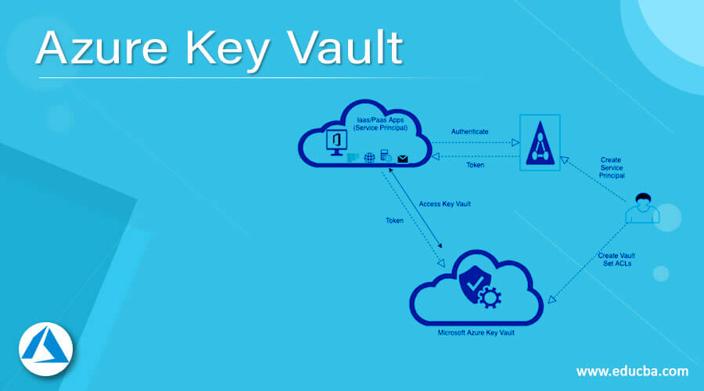
You have been tasked with delegate administrative access to your company גTM€s Azure key vault. You have to make sure that a specific user can set advanced access policies for the key vault. You also have to make sure that access is assigned based on the principle of least privilege. Which of the following options should you use to achieve your goal?
RBAC
Next - You have to make sure that a specific user is able to add and delete certificates in the key vault. You also have to make sure that access is assigned based on the principle of least privilege. Which of the following options should you use to achieve your goal?
A key vault access policy

Slide 20
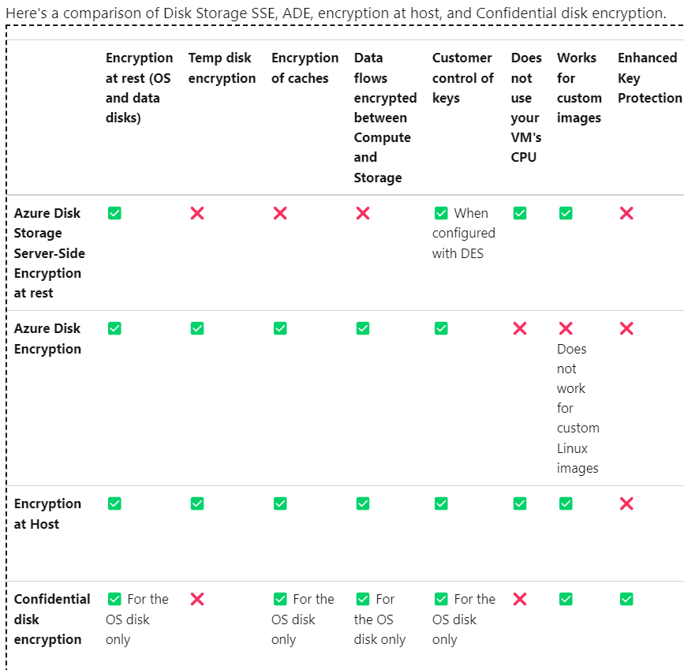
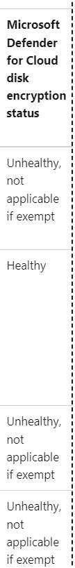
You have an Azure virtual machine that runs Windows Server R2. You plan to deploy and configure an Azure Key vault and enable Azure Disk Encryption for the virtual machine. Which of the following is TRUE with regards to Azure Disk Encryption for a Windows VM?
- It is supported for standard tier VMs.
You have an Azure virtual machine that runs Ubuntu 16.04-DAILY-LTS. You plan to deploy and configure an Azure Key vault and enable Azure Disk Encryption for the virtual machine. Which of the following is TRUE with regards to Azure Disk Encryption for a Linux VM?
- It is NOT supported for basic tier VMs.

Slide 21
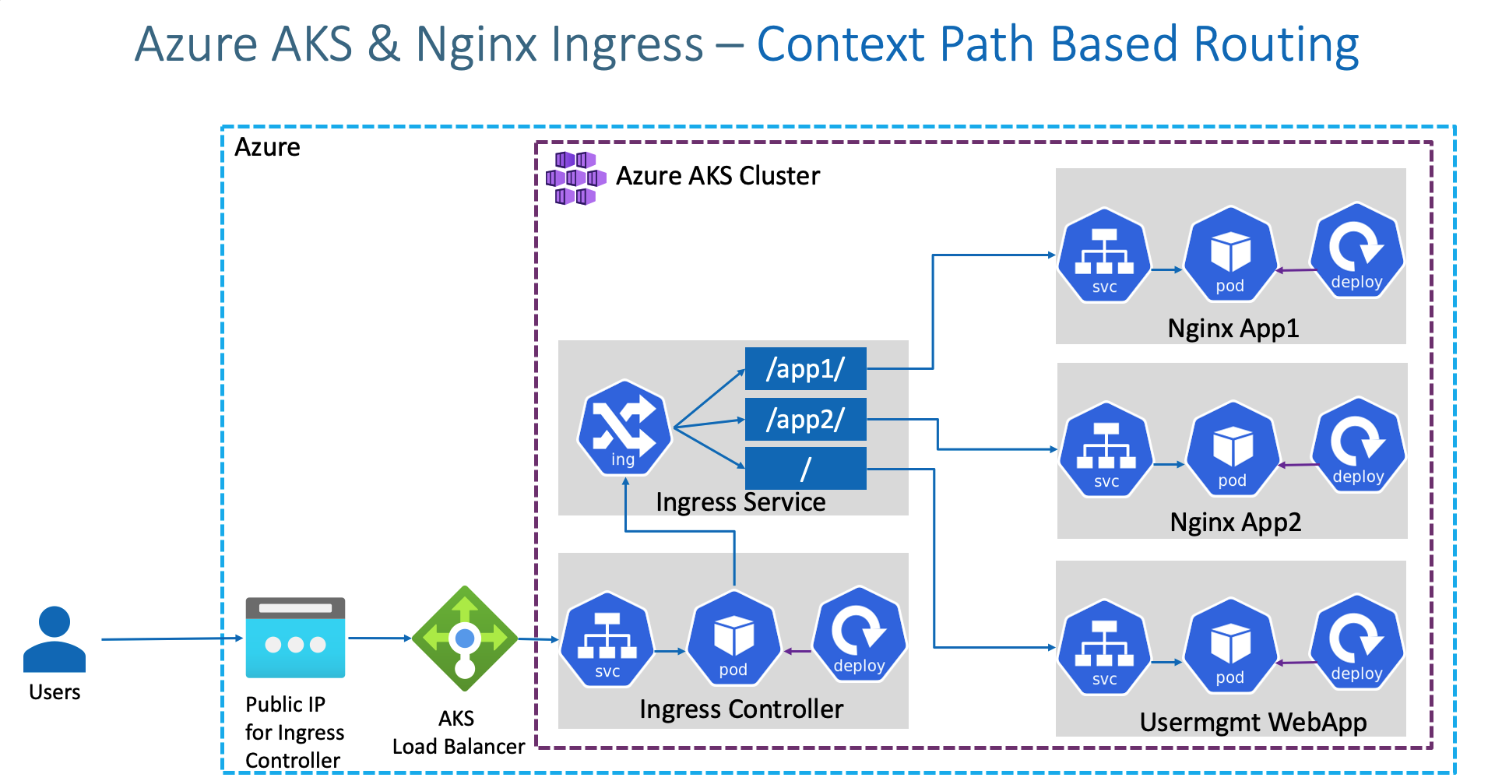
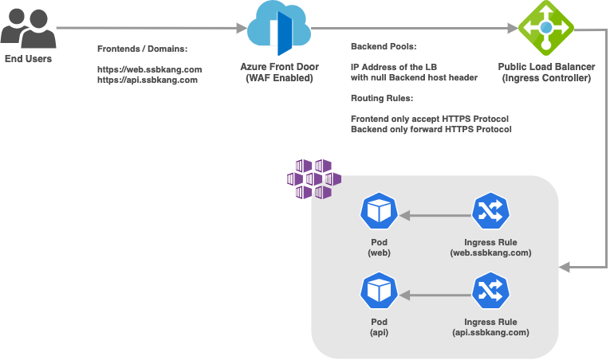
You have configured an Azure Kubernetes Service (AKS) cluster in your testing environment. You are currently preparing to deploy the cluster to the production environment. After disabling HTTP application routing, you want to replace it with an application routing solution that allows for reverse proxy and TLS termination for AKS services via a solitary IP address. You must create an AKS Ingress controller. select the accurate option.
No adjustment required.
Note: An ingress controller is a piece of software that provides reverse proxy, configurable traffic routing, and TLS termination for Kubernetes services

Slide 22
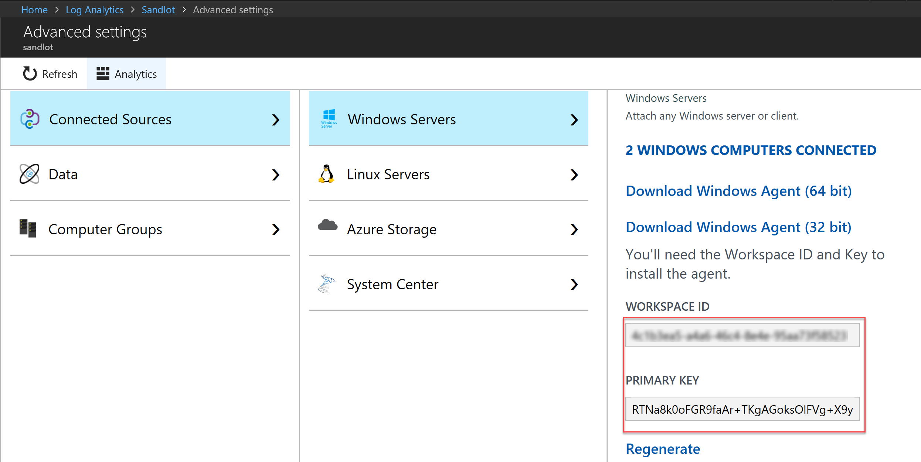
You want to gather logs from a large number of Windows Server 2016 computers using Azure Log Analytics. You are configuring an Azure Resource Manager template to deploy the Microsoft Monitoring Agent to all the servers automatically. Which of the following should be included in the template?
- WorkspaceID
- WorkspaceKey

Slide 23
Your company has Azure subscription linked to their Azure Active Directory (Azure AD) tenant. As a Global administrator for the tenant, part of your responsibilities involves managing Azure Security Center settings. You are currently preparing to create a custom sensitivity label.
- First you have to create a custom sensitive information type.
Here is the documentation:
1- Create Sensitive Info type
2- Create Pattern
3- Choose Confidence level
4- Choose and define primary elements
5- Value for char prox
6- Choose recommend confidence level
7 - Submit

Slide 24
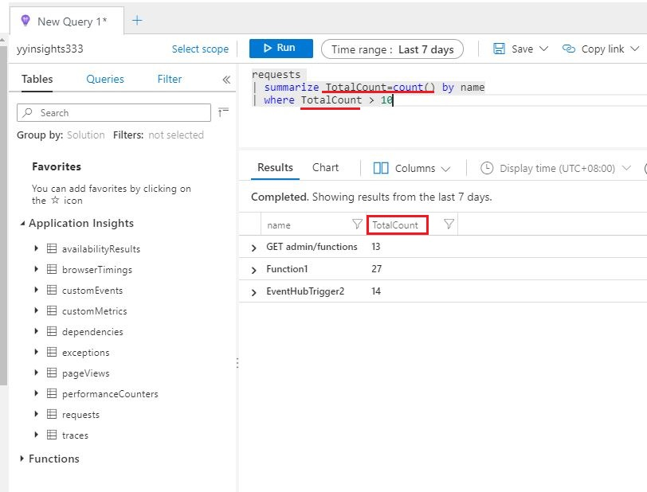
You have a sneaking suspicion that there are users trying to sign in to resources which are inaccessible to them. You decide to create an Azure Log Analytics query to confirm your suspicions. The query will detect unsuccessful user sign-in attempts from the last few days. You want to make sure that the results only show users who had failed to sign-in more than five times. Which of the following should be included in your query?
- EventID and Count() parameters.

Slide 25
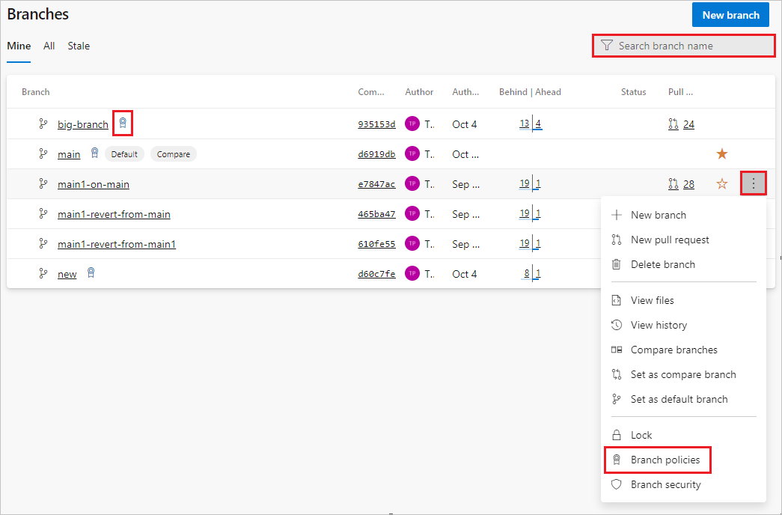
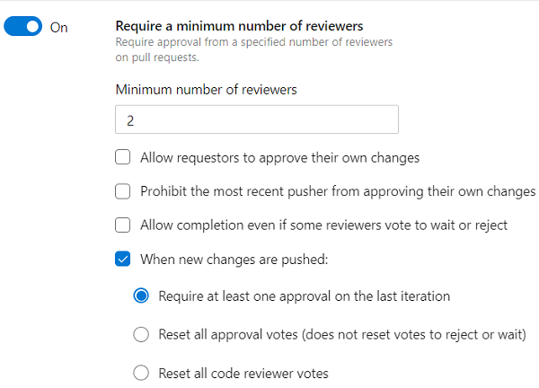
Your company uses Azure DevOps with branch policies configured. Which of the following is TRUE with regards to branch policies? (Choose all that apply.)
- It enforces your team's change management standards
- It enforces your team's code quality.
Branch policies help teams protect their important branches of development. Policies enforce your team's code quality and change management standards.

Slide 26
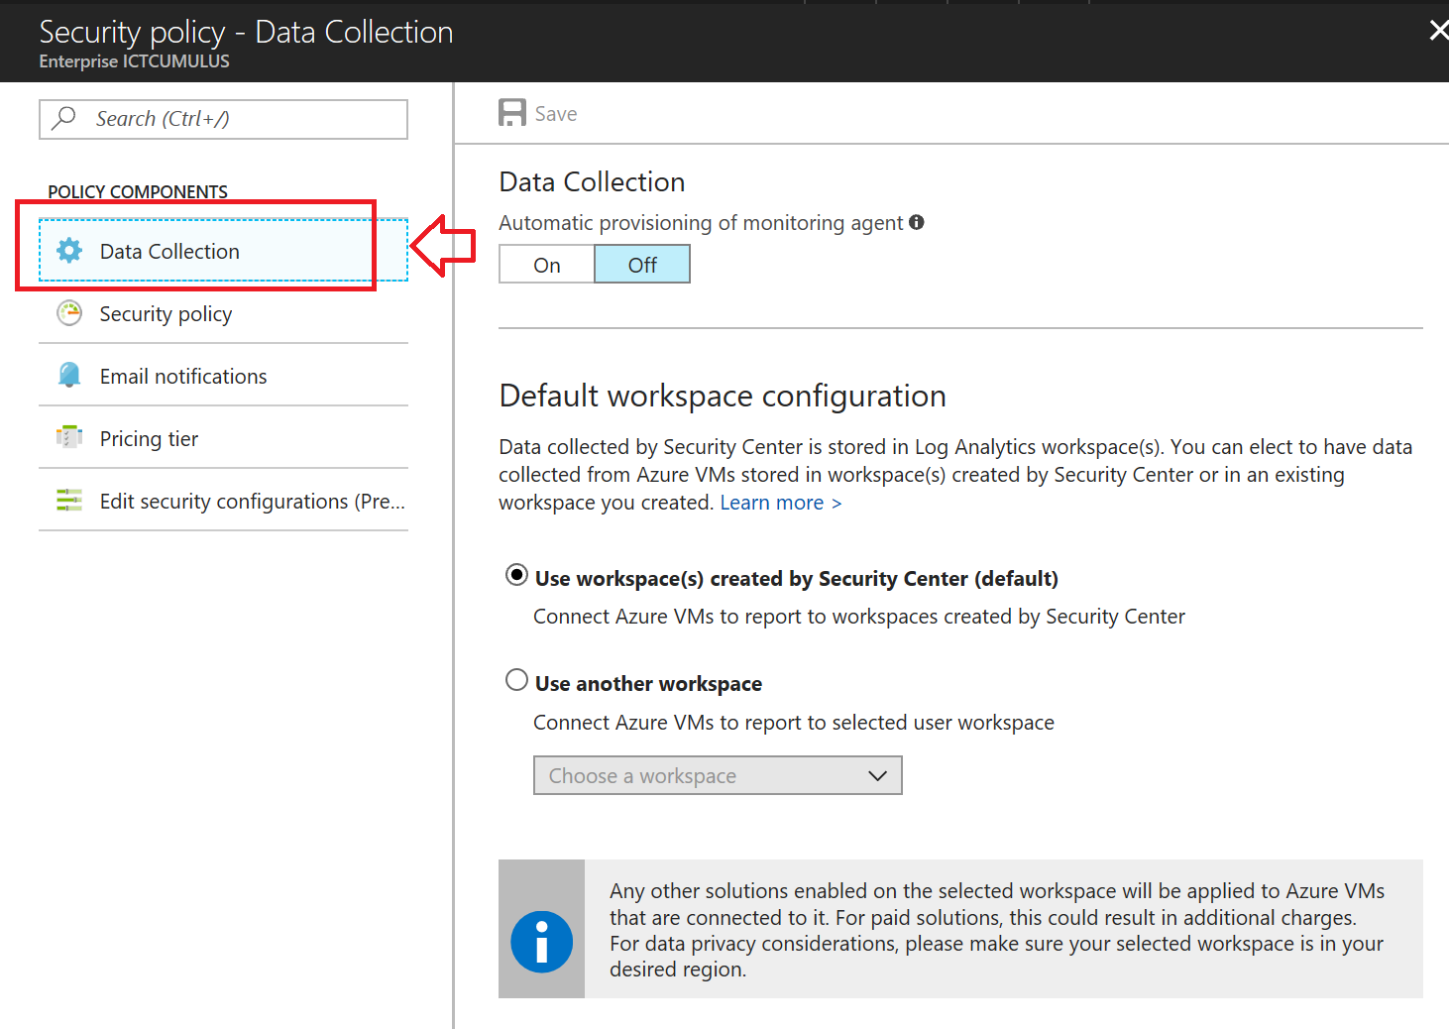
After creating a new Azure subscription, you are tasked with making sure that custom alert rules can be created in Azure Security Center. You have created an Azure Storage account. Which of the following is the action you should take?
-You should create an Azure Log Analytics workspace
You need write permission in the workspace that you select to store your custom alert.

Slide 27
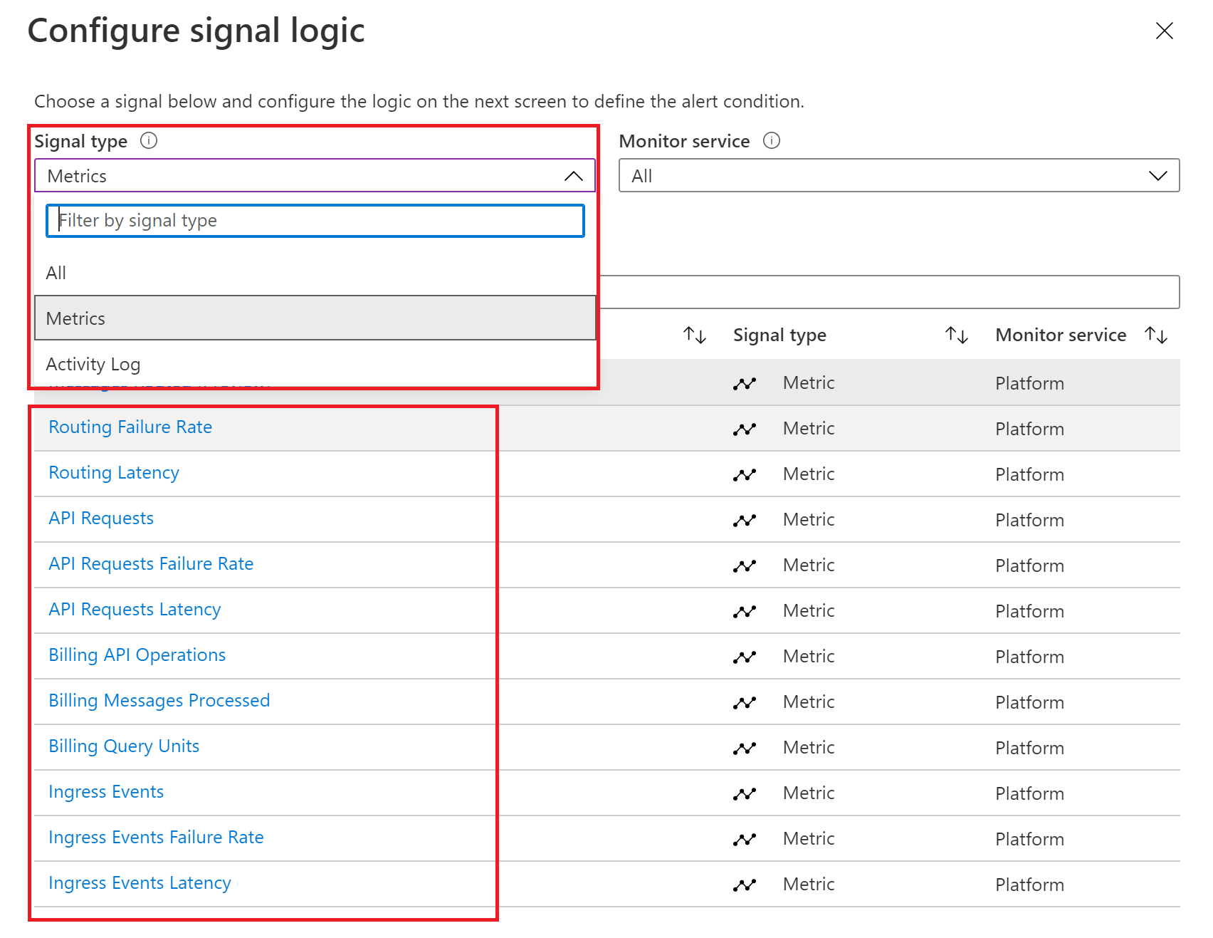
Your company גTM€s Azure subscription includes an Azure Log Analytics workspace. Your company has a hundred on-premises servers that run either Windows Server 2012 R2 or Windows Server 2016, and is linked to the Azure Log Analytics workspace. The Azure Log Analytics workspace is set up to gather performance counters associated with security from these linked servers. You have been tasked with configuring alerts according to the information gathered by the Azure Log Analytics workspace. You have to make sure that alert rules allow for dimensions, and that alert creation time should be kept to a minimum. Furthermore, a single alert notification must be created when the alert is created and when the alert is sorted out. You need to make use of the necessary signal type when creating the alert rules. Which of the following is the option you should use?
You should make use of the Metric signal type.
Metric alerts in Azure Monitor provide a way to get notified when one of your metrics cross a threshold. Metric alerts work on a range of multi-dimensional platform metrics, custom metrics, Application Insights standard and custom metrics. Note: Signals are emitted by the target resource and can be of several types. Metric, Activity log, Application Insights, and Log.

Slide 28
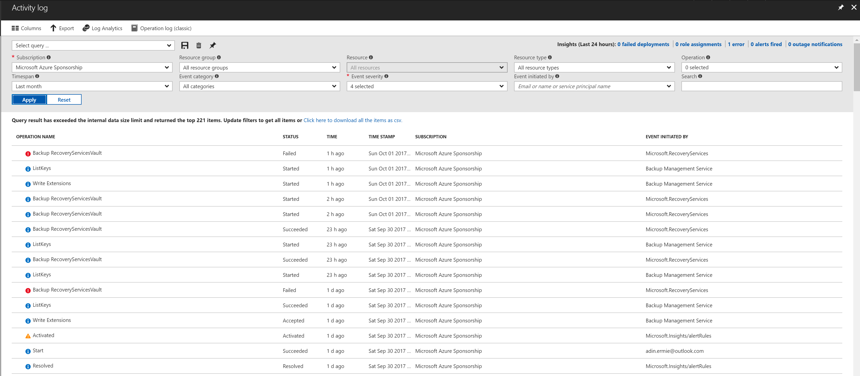
Your company גTM€s Azure subscription includes a hundred virtual machines that have Azure Diagnostics enabled. You have been tasked with retrieving the identity of the user that removed a virtual machine fifteen days ago. You have already accessed Azure Monitor. Which of the following options should you use?
-Activity Log
Azure activity logs provide insight into the operations that were performed on resources in your subscription. Activity logs were previously known as ג€audit logs ג €or ג€operational logs, ג €because they report control-plane events for your subscriptions.

Slide 29
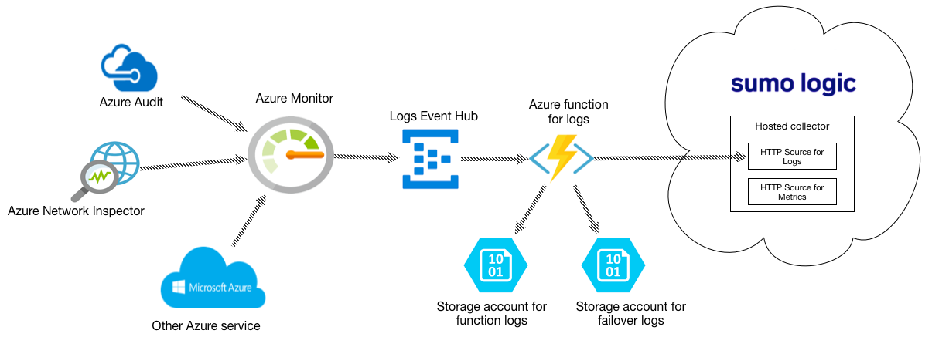
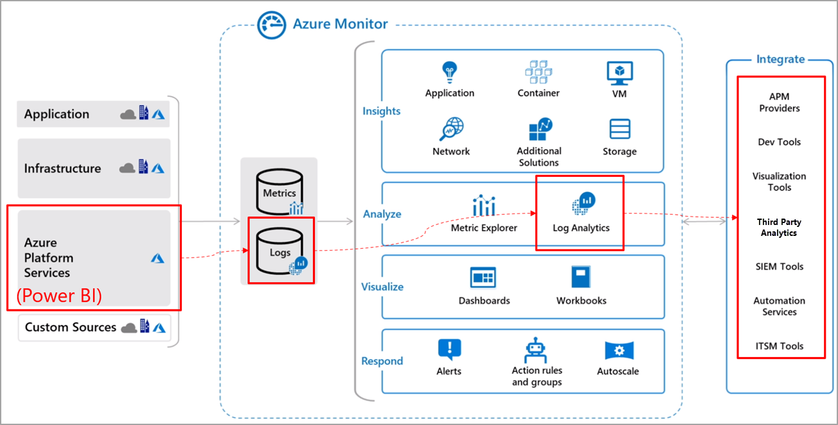
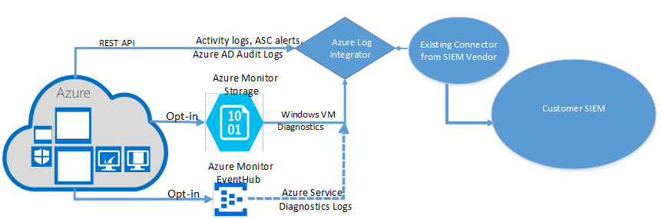
Your company גTM€s Azure subscription includes a hundred virtual machines that have Azure Diagnostics enabled. You have been tasked with analyzing the security events of a Windows Server 2016 virtual machine. You have already accessed Azure Monitor. Which of the following options should you use?
-Logs
Explanation: Log Integration collects Azure diagnostics from your Windows virtual machines, Azure activity logs, Azure Security Center alerts, and Azure resource provider logs. This integration provides a unified dashboard for all your assets, whether they're on-premises or in the cloud, so that you can aggregate, correlate, analyze, and alert for security events.

Slide 30
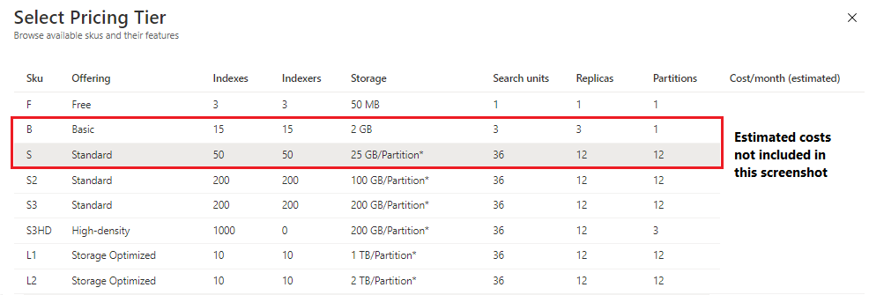
You have been tasked with making sure that you are able to modify the operating system security configurations via Azure Security Center. To achieve your goal, you need to have the correct pricing tier for Azure Security Center in place. Which of the following is the pricing tier required?
-Standard

Slide 31
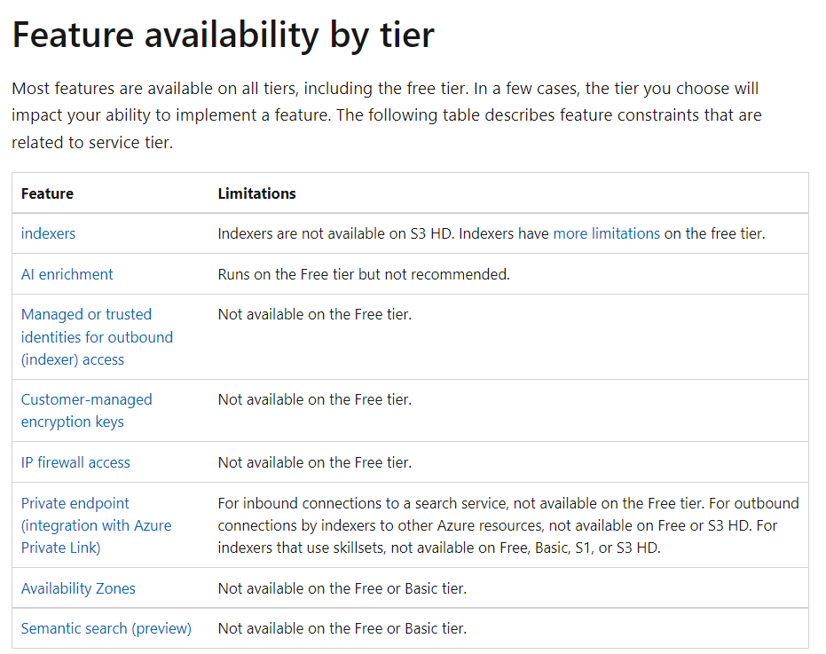

Slide 32
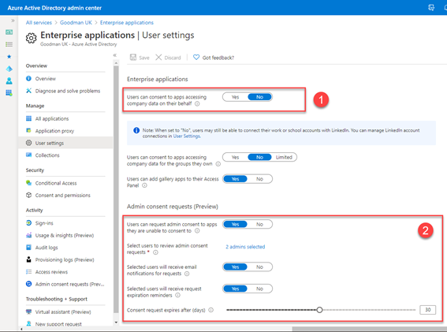
Your company גTM€s Azure subscription is linked to their Azure Active Directory (Azure AD) tenant. After an internally developed application is registered in Azure AD, you are tasked with making sure that the application has the ability to access Azure Key Vault secrets on application the users ג TM€behalf.
Solution: You configure a delegated permission with no admin consent.
Explanation: Delegated permissions - Your client application needs to access the web API as the signed-in user, but with access limited by the selected permission. This type of permission can be granted by a user unless the permission requires administrator consent.

Slide 33
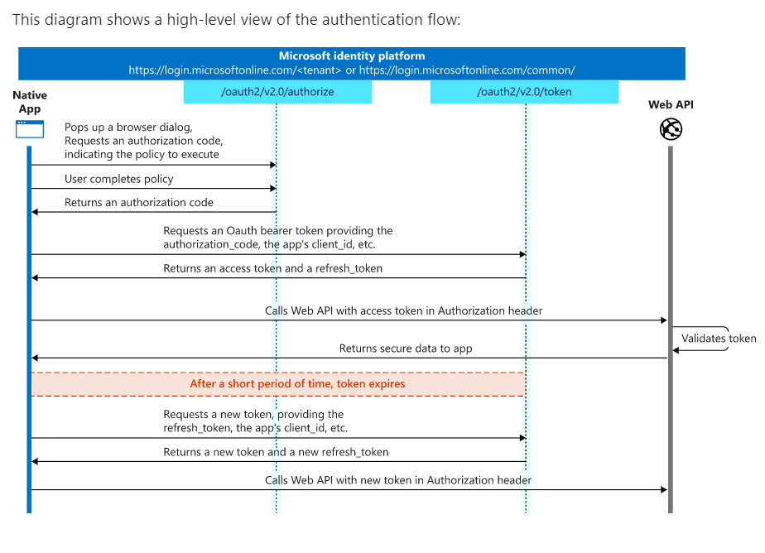
Your Azure Active Directory Azure (Azure AD) tenant has an Azure subscription linked to it. Your developer has created a mobile application that obtains Azure AD access tokens using the OAuth 2 implicit grant type. The mobile application must be registered in Azure AD. You require a redirect URI from the developer for registration purposes.
Explanation: For Native Applications you need to provide a Redirect URI, which Azure AD will use to return token responses.

Slide 34
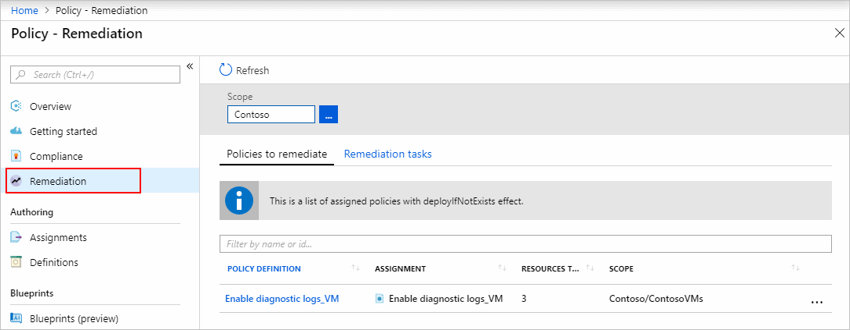
You are in the process of configuring an Azure policy via the Azure portal. Your policy will include an effect that will need a managed identity for it to be assigned. Which of the following is the effect in question?
C. DeployIfNotExist
Explanation: When Azure Policy runs the template in the deployIfNotExists policy definition, it does so by using a managed identity.

Slide 35
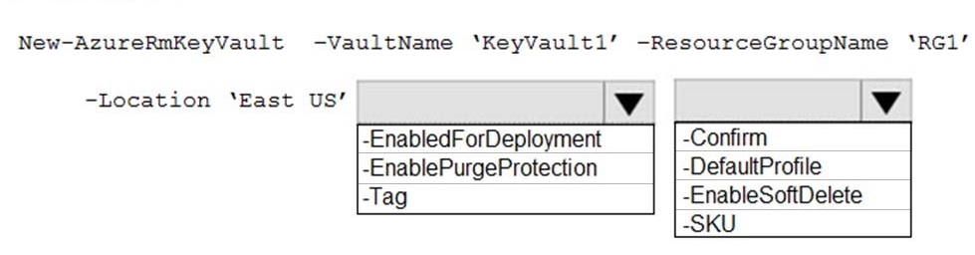
You have been tasked with creating an Azure key vault using PowerShell. You have been informed that objects deleted from the key vault must be kept for a set period of 90 days. Which two of the following parameters must be used in conjunction to meet the requirement?
EnablePurgeProtection
EnableSoftDelete

Slide 36
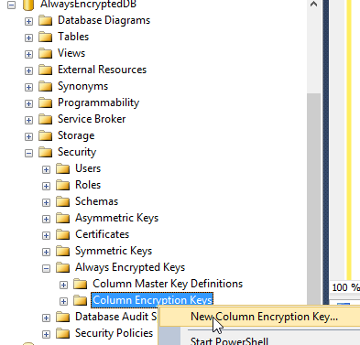
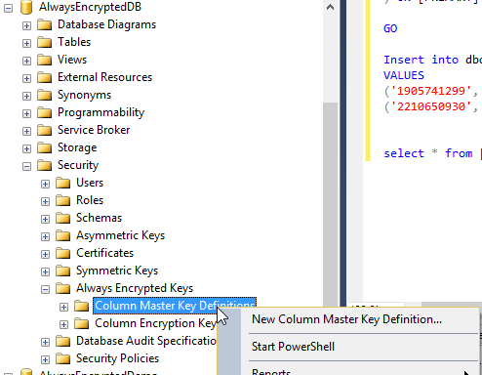
You are required to make the relevant information available to application developers to allow them to access data in the database. Which two of the following options should be made available?
Always Encrypted uses two types of keys: column encryption keys and column master keys.
A column encryption key is used to encrypt data in an encrypted column. A column master key is a key-protecting key that encrypts one or more column encryption keys.

Slide 37
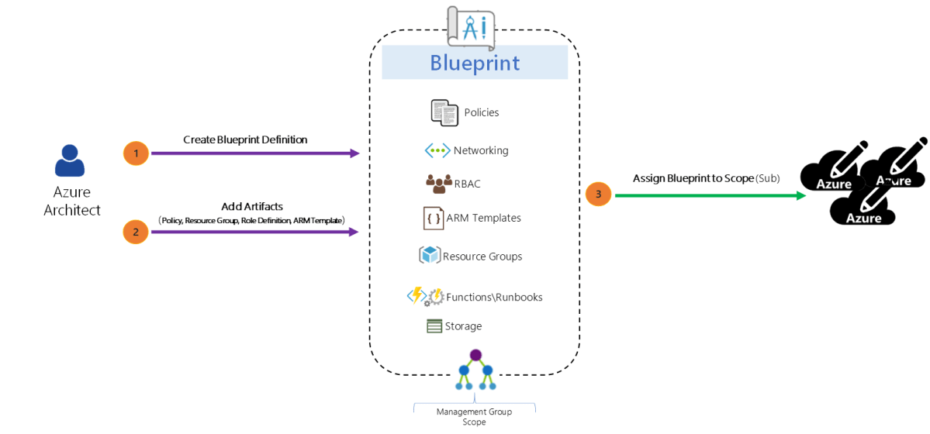
Just as a blueprint allows an engineer or an architect to sketch a project's design parameters, Azure Blueprints enables cloud architects and central information technology groups to define a repeatable set of Azure resources that implements and adheres to an organization's standards, patterns, and requirements. Blueprints are a declarative way to orchestrate the deployment of various resource templates and other artifacts such as: ✑ Role Assignments ✑ Policy Assignments ✑ Azure Resource Manager templates ✑ Resource Groups

Slide 38
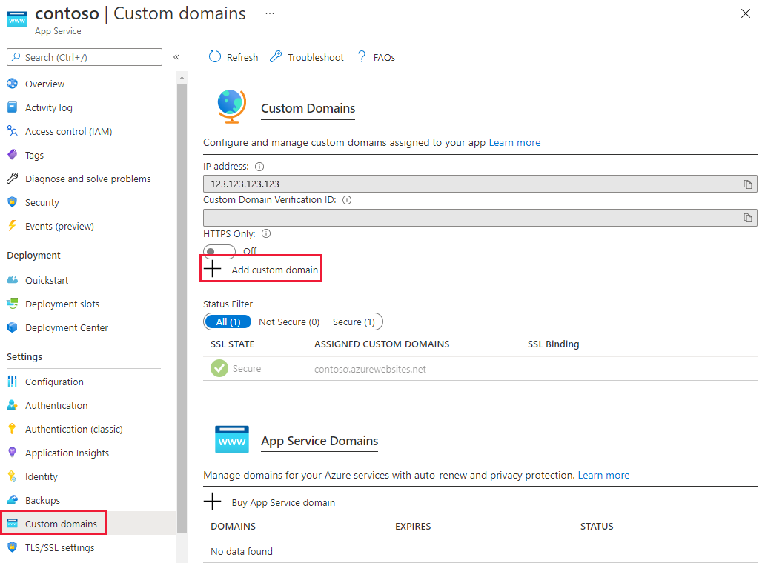
- You can configure Azure DNS to host a custom domain for your web apps. For example, you can create an Azure web app and have your users access it using either www.contoso.com or contoso.com as a fully qualified domain name (FQDN). To do this, you must create three records: A root "A" record pointing to contoso.com A root "TXT" record for verification A "CNAME" record for the www name that points to the A record - To use HTTPS, you need to upload a PFX file to the Azure Web App. The PFX file will contain the SSL certificate required for HTTPS.

Slide 39
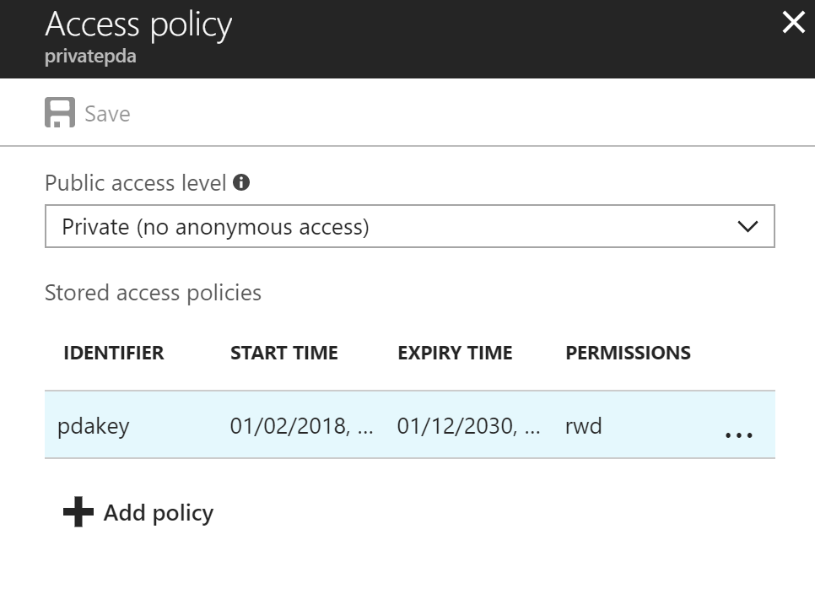
To revoke a stored access policy, you can either delete it, or rename it by changing the signed identifier. Changing the signed identifier breaks the associations between any existing signatures and the stored access policy. Deleting or renaming the stored access policy immediately affects all of the shared access signatures associated with it.

Slide 40
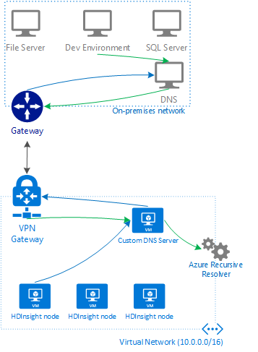
If you connect HDInsight to your on-premises network by using Azure Virtual Networks and a VPN gateway. Note: To allow HDInsight and resources in the joined network to communicate by name, you must perform the following actions: ✑ Create Azure Virtual Network. ✑ Create a custom DNS server in the Azure Virtual Network. ✑ Configure the virtual network to use the custom DNS server instead of the default Azure Recursive Resolver. ✑ Configure forwarding between the custom DNS server and your on-premises DNS server.

Slide 41
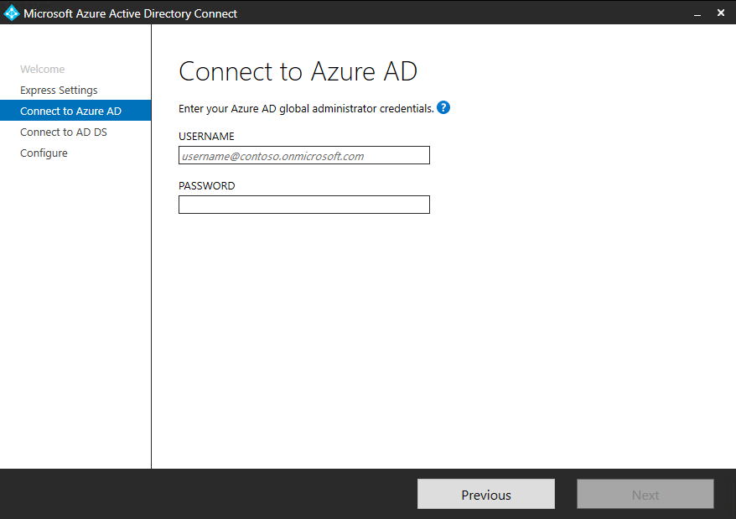
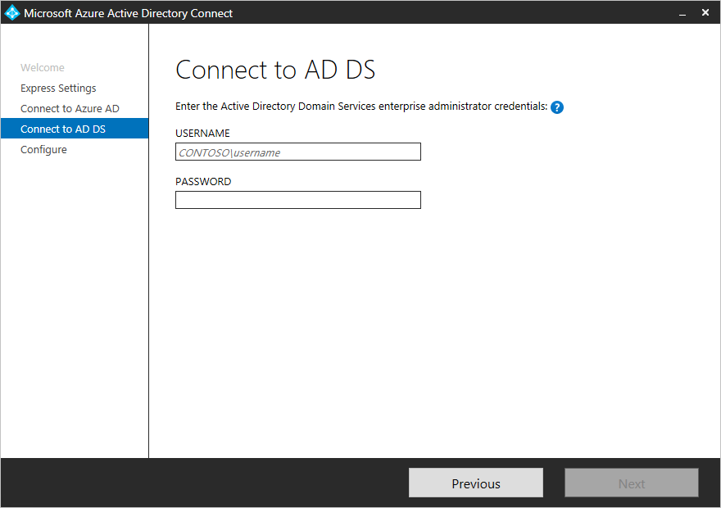
Your network contains an Active Directory forest named contoso.com. You have an Azure Active Directory (Azure AD) tenant named contoso.com. You plan to configure synchronization by using the Express Settings installation option in Azure AD Connect. You need to identify which roles and groups are required to perform the planned configuration. The solution must use the principle of least privilege. Which two roles and groups should you identify?
- the Global administrator role in Azure AD
- the Enterprise Admins group in Active Directory

Slide 42
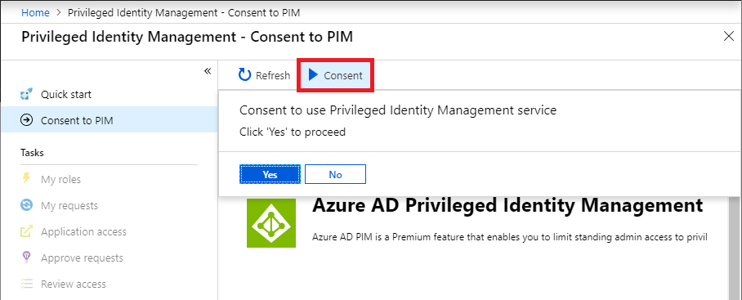
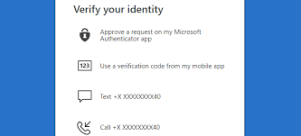

You create an Azure subscription with Azure AD Premium P2. You need to ensure that you can use Azure Active Directory (Azure AD) Privileged Identity Management (PIM) to secure Azure AD roles. Which three actions should you perform in sequence?
Step: 1 Consent to PIM
Step: 2 Verify your identity by using multi-factor authentication (MFA) Click Verify my identity to verify your identity with Azure MF You'll be asked to pick an account. Step 3: Sign up PIM for Azure AD roles Once you have enabled PIM for your directory, you'll need to sign up PIM to manage Azure AD roles.

Slide 43

You have an Azure subscription named Sub1. You have an Azure Storage account named sa1 in a resource group named RG1. Users and applications access the blob service and the file service in sa1 by using several shared access signatures (SASs) and stored access policies. You discover that unauthorized users accessed both the file service and the blob service. You need to revoke all access to sa1.
- You regenerate the Azure storage account access keys.

Slide 44



You have an Azure Active Directory (Azure AD) tenant named contoso.com that contains the users shown in the following table.
Azure AD Privileged Identity Management (PIM) is used in contoso.com. In PIM, the Password Administrator role has the following settings: ✑ Maximum activation duration (hours): 2 ✑ Send email notifying admins of activation: Disable ✑ Require incident/request ticket number during activation: Disable ✑ Require Azure Multi-Factor Authentication for activation: Enable ✑ Require approval to activate this role: Enable ✑ Selected approver: Group1 You assign users the Password Administrator role as shown in the following table.
For each of the following statements, select Yes if the statement is true. Otherwise, select No.
Explanation: Box 1: Yes - Active assignments don't require the member to perform any action to use the role. Members assigned as active have the privileges assigned to the role at all times. Box 2: Yes - While Multi-Factor Authentication is disabled for User2 and the setting Require Azure Multi-Factor Authentication for activation is enabled, User2 can request the role but will need to enable MFA to use the role. Note: Eligible assignments require the member of the role to perform an action to use the role. Actions might include performing a multi-factor authentication (MFA) check, providing a business justification, or requesting approval from designated approvers.
Box 3: No - User3 is Group1, which is a Selected Approver Group, however, self-approval is not allowed and someone else from group is required to approve the request.

Slide 45


You have a hybrid configuration of Azure Active Directory (Azure AD) that has Single Sign-On (SSO) enabled. You have an Azure SQL Database instance that is configured to support Azure AD authentication. Database developers must connect to the database instance from the domain joined device and authenticate by using their on-premises Active Directory account. You need to ensure that developers can connect to the instance by using Microsoft SQL Server Management Studio. The solution must minimize authentication prompts. Which authentication method should you recommend?
- Active Directory – Integrated Details: Azure Active Directory Authentication is a mechanism of connecting to Microsoft Azure SQL Database by using identities in Azure Active Directory (Azure AD). Use this method for connecting to SQL Database if you are logged in to Windows using your Azure Active Directory credentials from a federated domain.

Slide 46

You plan to use Azure Resource Manager templates to perform multiple deployments of identically configured Azure virtual machines. The password for the administrator account of each deployment is stored as a secret in different Azure key vaults. You need to identify a method to dynamically construct a resource ID that will designate the key vault containing the appropriate secret during each deployment. The name of the key vault and the name of the secret will be provided as inline parameters. What should you use to construct the resource ID?
- a parameters file
Explanation: You reference the key vault in the parameter file, not the template. The following image shows how the parameter file references the secret and passes that value to the template.
az group deployment create --name acsenginedeploy -g sample-group --template-file azuredeploy.json --parameters @azuredeploy.parameters.json

Slide 47



Slide 48


You have an Azure subscription named Sub 1 that is associated to an Azure Active Directory (Azure AD) tenant named contoso.com.
The tenant contains the users shown in the following table.
Each user is assigned an Azure AD Premium P2 license. You plan to onboard and configure Azure AD Identity Protection. Which users can onboard Azure AD Identity Protection, remediate users, and configure policies?
To answer, select the appropriate options in the answer area.

Slide 49


Slide 50
You need to configure an access review. The review will be assigned to a new collection of reviews and reviewed by resource owners. Which three actions should you perform in sequence? To answer, move the appropriate actions from the list of actions to the answer area and arrange them in the correct order. Select and Place:
Step 1: Create an access review program Step 2: Create an access review control Step 3: Set Reviewers to Group owners In the Reviewers section, select either one or more people to review all the users in scope. Or you can select to have the members review their own access. If the resource is a group, you can ask the group owners to review.

Slide 51

When you transfer billing ownership of your subscription to an account in another Azure AD tenant, you can move the subscription to the new account's tenant. If you do so, all users, groups, or service principals who had role-based access (RBAC) to manage subscriptions and its resources lose their access. Only the user in the new account who accepts your transfer request will have access to manage the resources.

Slide 52
You have an Azure subscription named Sub1. You have an Azure Storage account named sa1 in a resource group named RG1. Users and applications access the blob service and the file service in sa1 by using several shared access signatures (SASs) and stored access policies. You discover that unauthorized users accessed both the file service and the blob service. You need to revoke all access to sa1.
Solution: You regenerate the Azure storage account access keys.
Explanation: Generating new storage account keys will invalidate all SASג€™s that were based on the previous keys.

Slide 53

WEB Q
The developers at your company plan to create a web app named example-app and to publish the app to https://www.contoso.com. You need to perform the following tasks: ✑ Ensure that example-app is registered to Azure Active Directory (Azure AD). ✑ Generate a password for example-app123.
To complete this task, sign into the Azure portal.
Step 1: Register the Application 1. Sign into your Azure Account through the Azure portal. 2. Select Azure Active Directory. 3. Select App registrations. 4. Select New registration. 5. Name the application 12345678. Select a supported account type, which determines who can use the application. Under Redirect URI, select Web for the type of application you want to create. Enter the URI: https://www.contoso.com , where the access token is sent to.

Slide 54


WEB Q – Continued…
Click Register Step 2: Create a new application secret If you choose not to use a certificate, you can create a new application secret. 7. Select Certificates & secrets. 8. Select Client secrets -> New client secret. 9. Provide a description of the secret, and a duration. When done, select Add. After saving the client secret, the value of the client secret is displayed. Copy this value because you aren't able to retrieve the key later. You provide the key value with the application ID to sign in as the application. Store the key value where your application can retrieve it.

Slide 55



You need to create a new Azure Active Directory (Azure AD) directory named 12345678.onmicrosoft.com and a user named User1 in the new directory. To complete this task, sign into the Azure portal.
To create a new Azure AD tenant: 1. Browse to the Azure portal and sign in with an account that has an Azure subscription. 2. Select the plus icon (+) and search for Azure Active Directory.
3. Select Azure Active Directory in the search results.
4. Select Create. 5. Provide an Organization name (12345678) and an Initial domain name (12345678). Then select Create. This will create the directory named 12345678.onmicrosoft.com.

Slide 56



6. After directory creation is complete, select the information box to manage your new directory. To create the user: 1. In the Azure portal, make sure you are on the Azure Active Directory fly out.
If not, select the Azure Active Directory icon from the left services navigation
2. Under Manage, select Users.
3. Select All users and then select + New user. 4. Provide a Name and Username (user12345678) for the user. When you're done, select Create. To enable MFA: 1. In the Azure portal, make sure you are on the Azure Active Directory fly out.
2. Under Manage, select Users.
3. Click on the Multi-Factor Authentication link. 4. Tick the checkbox next to the user's name and click the Enable link.

Slide 57

You configure the subscription to use a different Azure Active Directory (Azure AD) tenant. What are two possible effects of the change? Each correct answer presents a complete solution. NOTE: Each correct selection is worth one point.
A. Role assignments at the subscription level are lost.
B. Virtual machine managed identities are lost.
--------------------
You have an Azure subscription that contains virtual machines. You enable just in time (JIT) VM access to all the virtual machines. You need to connect to a virtual machine by using Remote Desktop. What should you do first?
- From the Azure portal, select the virtual machine, select Connect, and then select Request access

